Slide 1
CADD USERS GROUP • April 13th, 2022

Slide 2
Welcome
Mark McCloud, CADD Services Manager
Office of CADD and Mapping Services
Notes:
Welcome everyone to our April CADD Users Group Live Event
Thank you for joining us this morning
My name is Mark McCloud and I’m the CADD Services Manager here at ODOT
We are recording this event and it will be made available on our Wiki page later today or tomorrow
We do have live chat available so please type in any questions you have, and we will field those as the meeting progresses
We will also be providing CPD’s for today via email so look for those in the future
NOTE: If you joined the meeting as anonymous, we cannot verify you attended the meeting
NOTE: If you're watching this event as a group, each person who would like CPD’s will still need to join the meeting separately

Slide 3
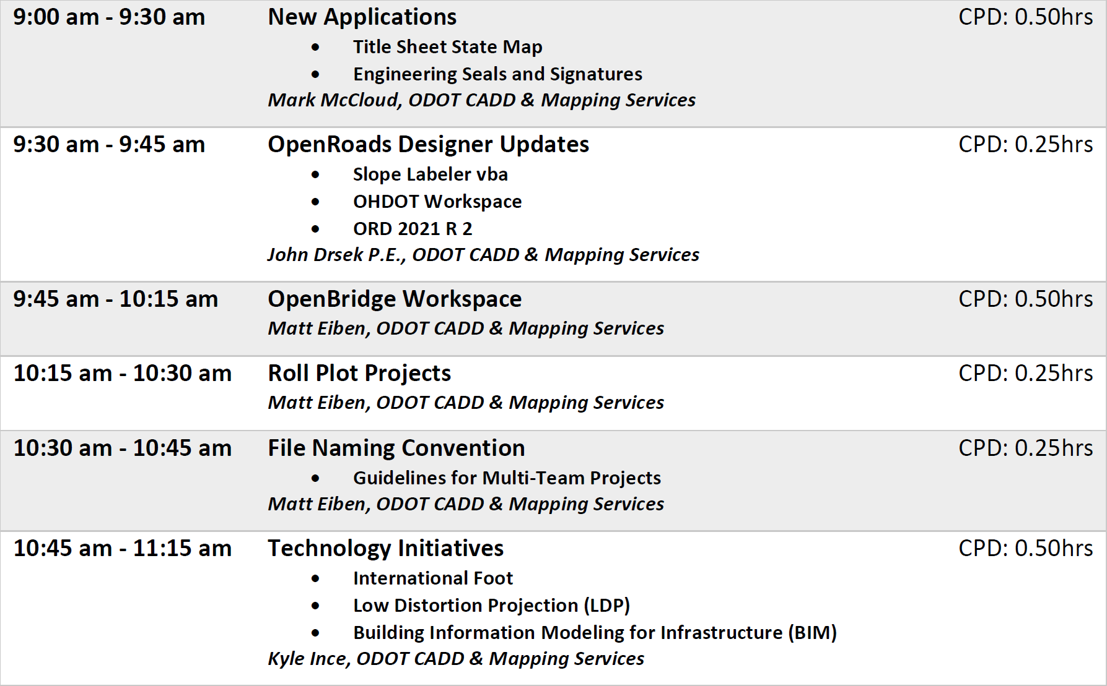
Agenda

Slide 4
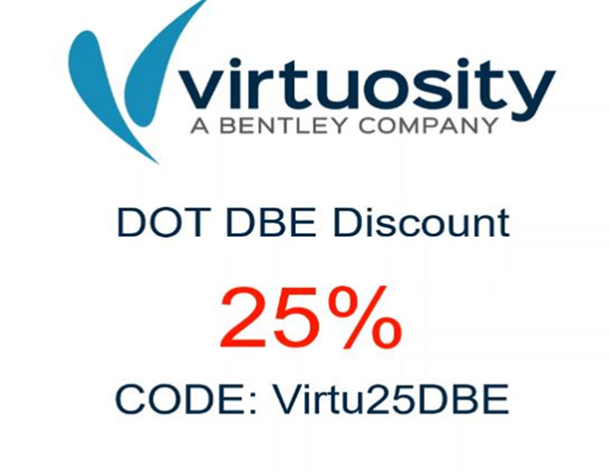
General Updates
Eric Thomas is no longer with ODOT CADD Services
CADD Services position available
  CADD Data Administration Manager 1
  http://careers.ohio.gov/
Bentley DBE Discount

Slide 5
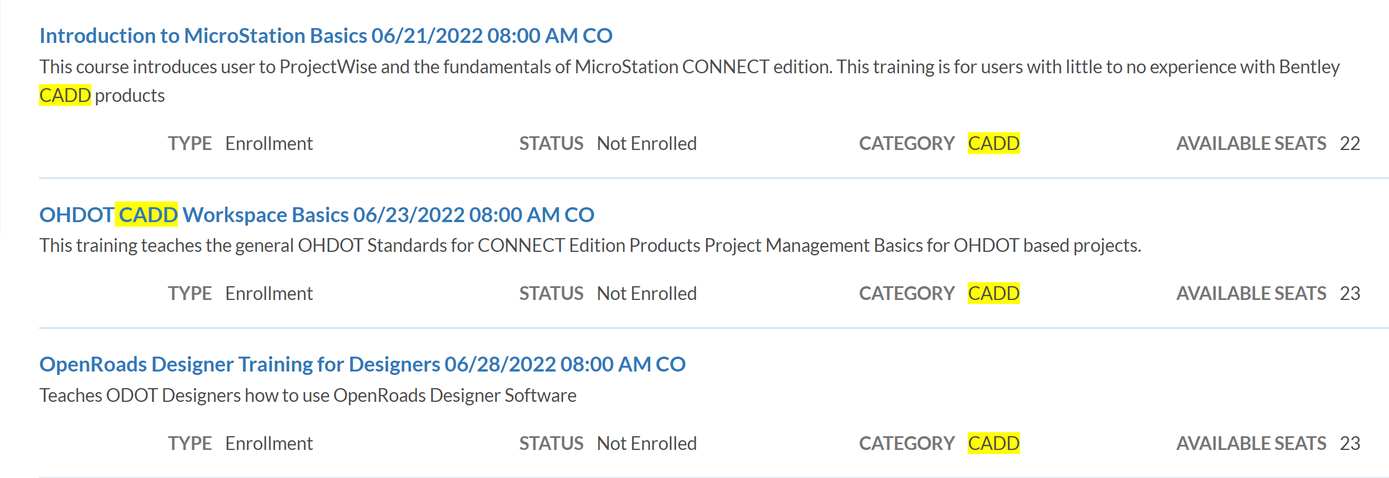
General Updates
ODOT Internal CADD Training

Slide 6
Slope Labeler
John Drsek, P.E.

Slide 7
Slope Labeler
Got a request for annotating existing slope.
XS are slices of the 3d model. The elements are not line strings.
Found and Updated app originally written by Larry Wilson (CMT) while at LJB.
Can place slope from two points.

Slide 8
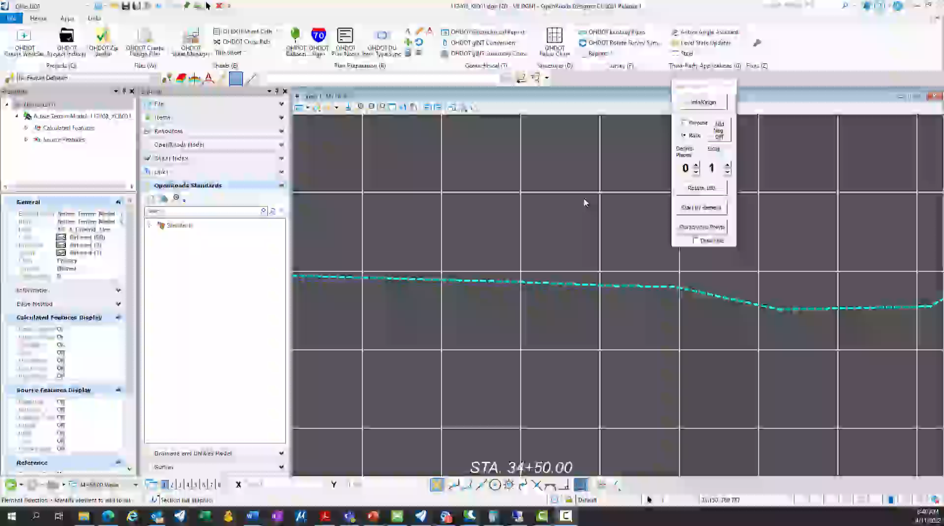
Slope Labeler Demo

Slide 9
OHDOT Workspace
John Drsek, P.E.

Slide 10
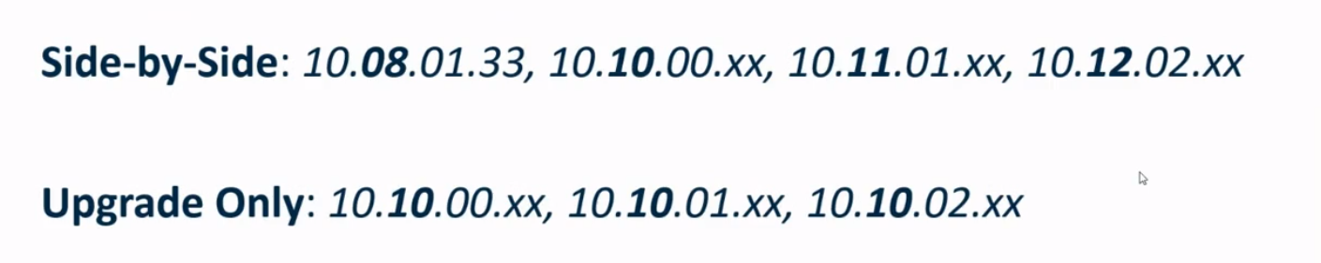


Some Reminders!
Side by Side Installs are now possible for major releases starting with 10.10

Slide 11
Some Reminders!
We have two workspaces for CONNECT!
  Main different is v1 uses Arial and v2 uses Calibri
  OHDOT (v1): has installer/sync tool (ORD 10.5 or newer)
  OHDOTCEv02 (v2) : installer/sync tool not done yet. Zip file download (must have ORD 10.10 or newer)
  All new projects moving forward should use v2 workspace
  Original timeline had 3/25/2022 as the last update for v1.
  Decided to continue to update v1 (per user's request).

Slide 12
Some Reminders!
When using the create workset application, it has not been updated to understand the install location of ORD 10.10.
  This means if your outside of PW the last step when creating a workset is to open ORD in the background and assign the workset seed files to the workset.
  If it cant find the workspace/workset then it cant assign the seed files
  The background process will then display on the screen and the app will just keep spinning waiting for the process to end. All you need to do is close the instance that started.
  Then just manually open each seed file to get them assigned to the workset and stop getting the annoying mismatch workset alert

Slide 13
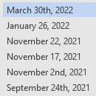
Recent Updates
Fixed a problem with OHDOT_Survey.mvba having dependances to PowerGEOPAK.
Updated Default user prefs to have Floating Origin toggled off.
Create workset app now puts version and username in the workset cfg file.

Slide 14
Recent Updates
Added Generic Utility Node Feature Definitions for communication, gas, electric…
Fixed GenericNode-X and –P FD (incorrectly set to outfall type)
Updated Bridge Site Plan sheet seed to use the sheet cell without the scale bar

Slide 15
ORD 2021 R2
John Drsek, P.E.

Slide 16
ORD 2021 R2
10.10.21.04 minor update
(1) OpenRoads Designer 2021 Release 2 Introduction – YouTube
Enhanced Station offset reports to report directly on 3d linear elements and survey features (don’t have to convert them to geometry elements)
Multi-threaded several processes that use named boundaries (Qtys by Named Boundaries, End Area volumes report)
  Performance gains range from 7x to 18x

Slide 17
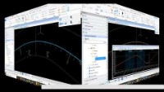
ORD 2021 R2
Earthwork: option for showing only removed qty (don’t show fill).
White Space Management!!!

Slide 18
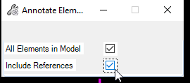
ORD 2021 R2
Component Middle annotation setting change.
  Plan and Profile annotations duplicated on each sheet it shows up on (curve spans multiple sheets = same annotation on all sheets the curve spans)
Annotate All Elements (References)
  Annotate and remove annotations from all elements in a reference file

Slide 19
ORD 2021 R2
End Area Volumes from multiple corridors on XS (place a Grid Annotation instead of Point)

Slide 20
Drainage
Retain graphics when the DGN and Database are out of sync!!
Cover Depths for nodes. Can now set min/max overs depths for nodes and the conduits will honor these when running a design scenario. (Conduit Cover at Node)
Fixed Projected Profile runs not projecting correctly (looking flipped or partially flipped)

Slide 21
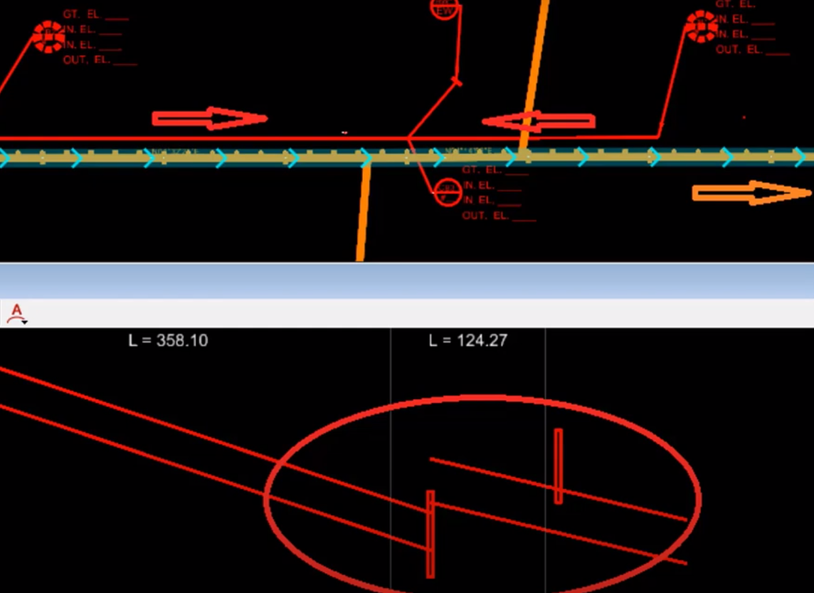
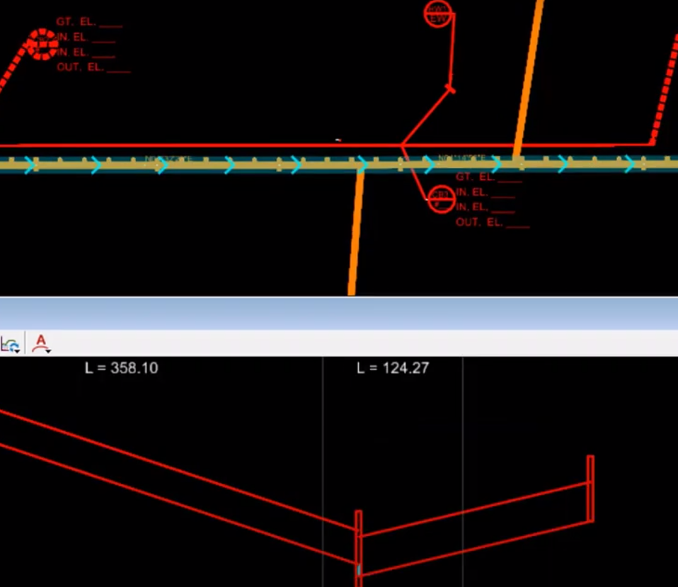
Drainage

Slide 22
Drainage Notes- Losing Faith in software?
Fixed a bug in 10.10.20 where you sometimes lost a change to a conduit's elevations – it snapped back to the invert of the node.
A workflow that can cause problems – where people make manual copies of a DGN that contains a D&U project. This Wiki article explains more: Best Practice: Do not manually copy a Design File with a Drainage and Utility Project to create a New Design File - OpenRoads | OpenSite Wiki - OpenRoads | OpenSite - Bentley Communities
Annotation is almost at a good point, now turning to plan prep graphics and what we need. Bentley is working on it.

Slide 23
ORD 2021-R2 – Problems
Breaks any VBA what places cell.
  Luckily we have moved a lot of our custom apps to Addins and away from VBA, but..
  OHDOT_Signs app will crash ORD 2021-R2
  New OHDOT_Seals app will crash ORD 2021-R2.
  Sheet Cells app will still work as its an addin
  Filed defect with Bentley (Defect 853196), no word on when fix will be
EAV table annotation still needs updated to grid annotation.
  Right now, it’s placing the table scaled too large.
Ohio DOT is waiting to see when the vba defect will be fixed to determine if we will move to this release or not.

Slide 24

ORD 2021-R2 – Poll
https://forms.office.com/g/EkC3LMNwPw

Slide 25
Questions
?

Slide 26
Ohdot Openbridge designer/modeler
Matt Eiben

Slide 27




OpenBridge workspace – Beta release
Available November 1, 2021.
OpenBridge Designer/Modeler 10.10.xx.xx.
Built with OHDOTCEv02.
No ODOT training resources available.
  Recommend Bentley Learn content.
    New content for 10.10.xx.xx.

Slide 28
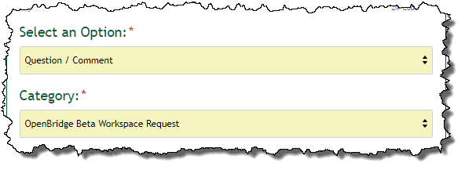
OpenBridge workspace – Beta release
Available by request.
  odot.formstack.com/forms/cadd_servicerequest
  Use category “OpenBridge Beta Workspace Request”
  Requesters will be part of Beta Group.

Slide 29


OpenBridge workspace
OpenBridge Modeler
  standalone install
  ProConcrete (some functions integrated*)
OpenBridge Designer
  LEAP Bridge Concrete, LEAP Bridge Steel, and RM Bridge
  OpenBridge Modeler
ProStructures
  ProSteel, ProConcete

Slide 30
OpenBridge workspace – HOW WE GOT HERE
Sept.-Oct. 2020
Feb.-April 2021
April-Oct. 2021
Coordinated with OSE.
Modified Bentley’s delivered workspace.
Paused for other priorities.
Discovery meetings w/ Bentley for use of Success Play.
Established Oct. 2021 beta release timeline.
Coordination with OSE, Bentley, CADD/Mapping.
Bentley reviewed and enhanced workspace.
Bentley is developing custom abutment parametric cells.

Slide 31
OpenBridge workspace – WHERE WE’RE GOING
Nov. 2021- Feb. 2022
Mar.-April 2022
May-June 2022
Begin Beta testing
Incorporate feedback
Official Release.
Collect feedback
Continuous development
Develop training material
Continuous workspace and training material development.
Continuous development.
This was an aggressive schedule.
Expected to slide to late 2022.

Slide 32
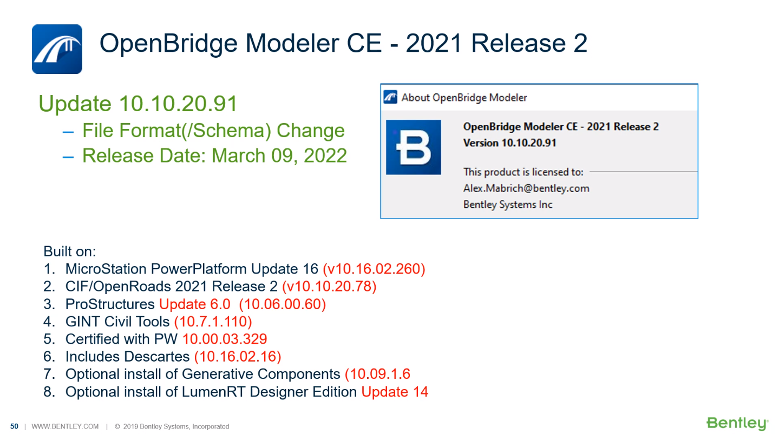
OPenBRidge Modeler 10.10.20.91

Slide 33
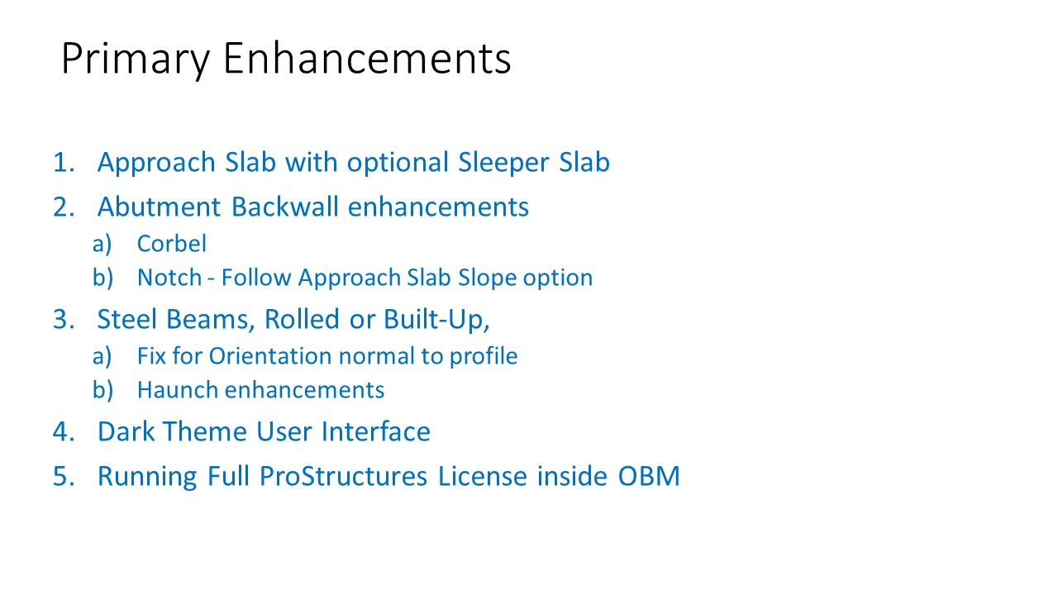
OPenBRidge Modeler 10.10.20.91

Slide 34
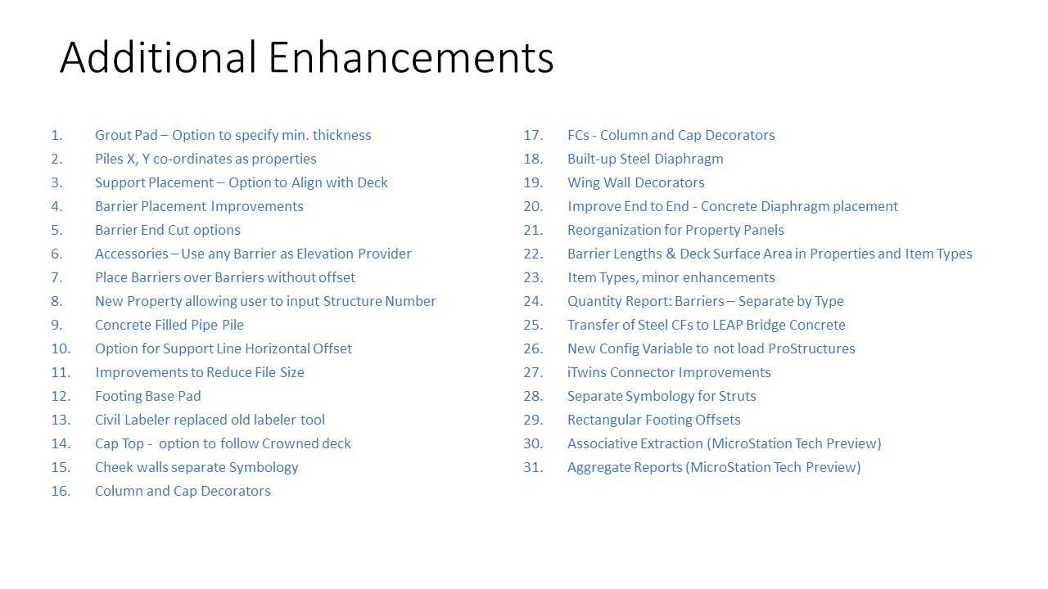
OPenBRidge Modeler 10.10.20.91

Slide 35
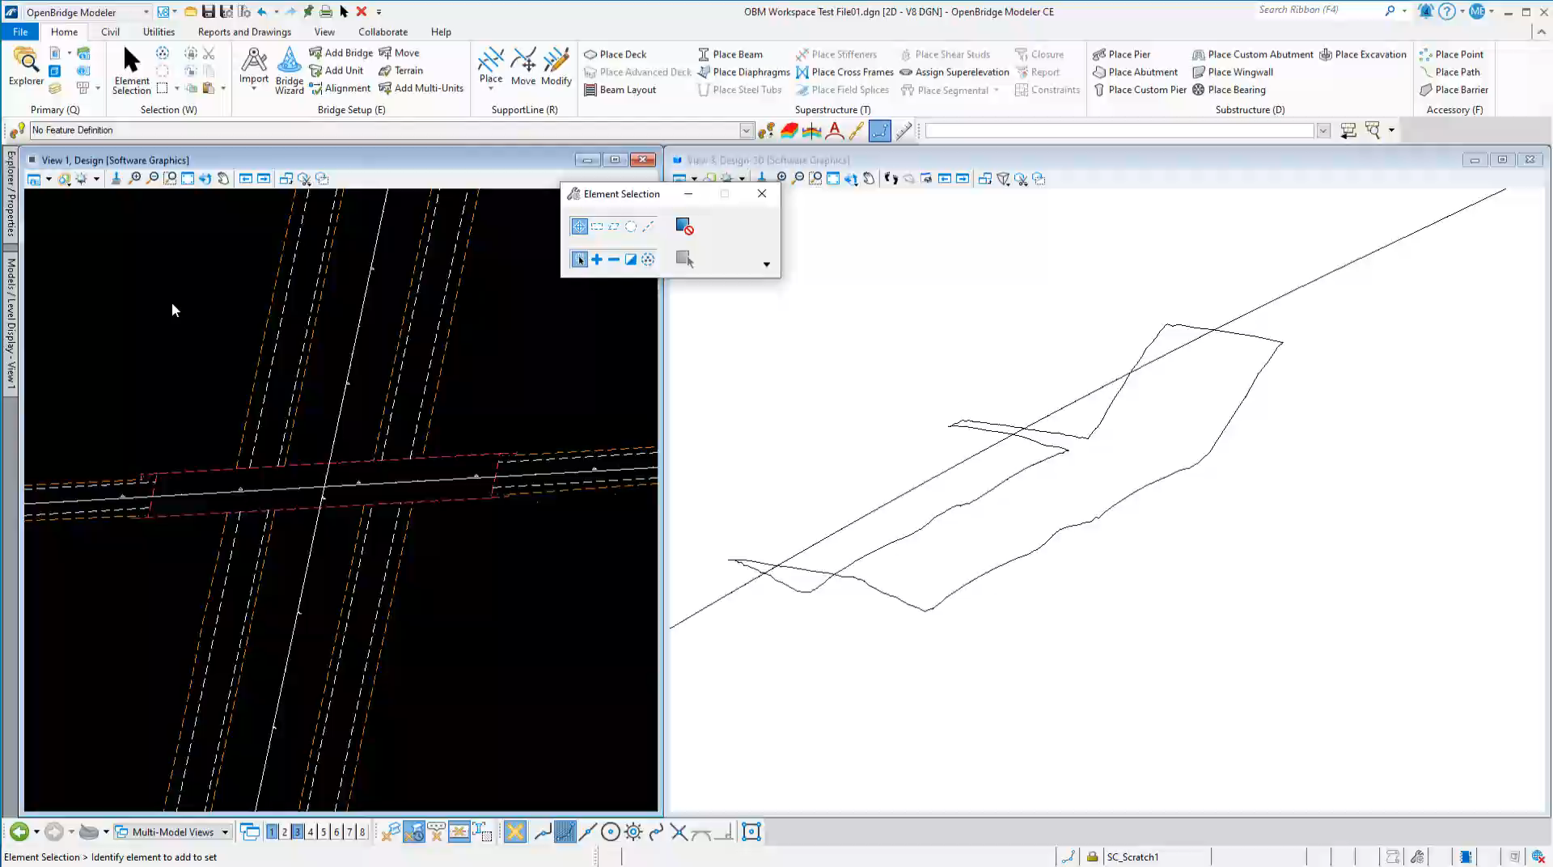
OpenBridge workspace - demo

Slide 36
OpenBridge workspace
Remember this is a beta release.
  Use for active project delivery your own risk!
We need your feedback.
  What works?
  What doesn’t?
  What can ODOT do to make the workspace more functional?

Slide 37
Questions
?

Slide 38
ODOT E+ Plans pilot
Matt Eiben

Slide 39
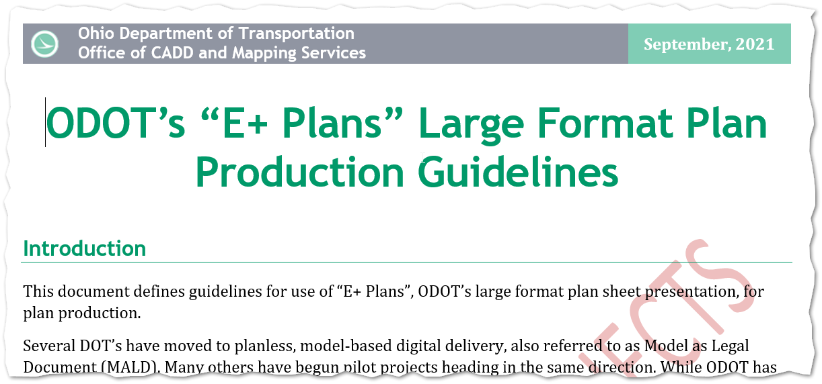
ODOT e+ Plans pilot

Slide 40
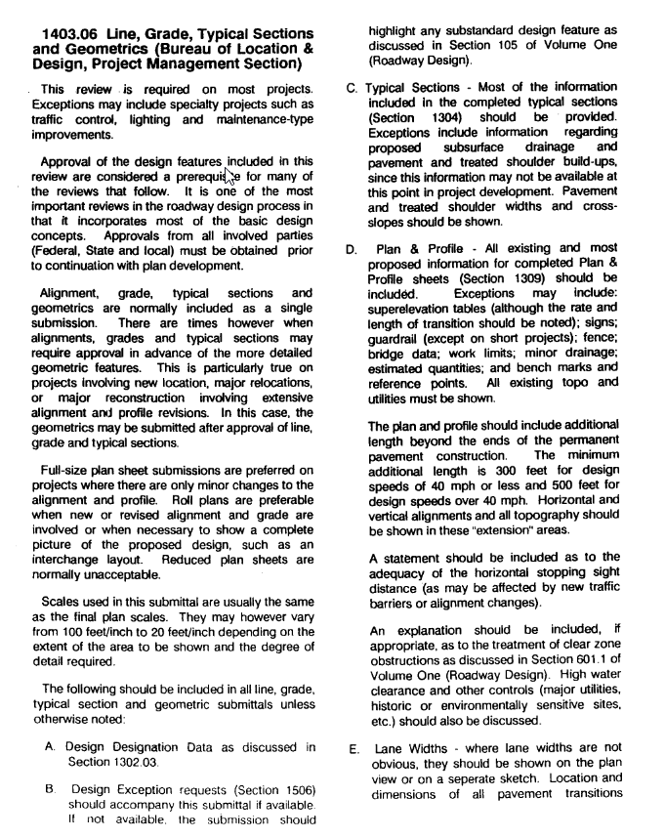
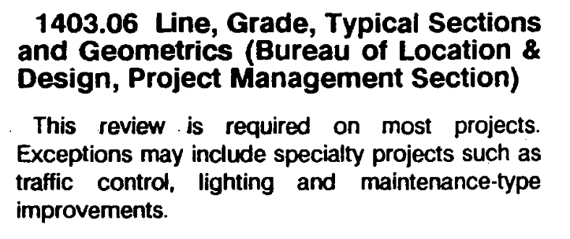
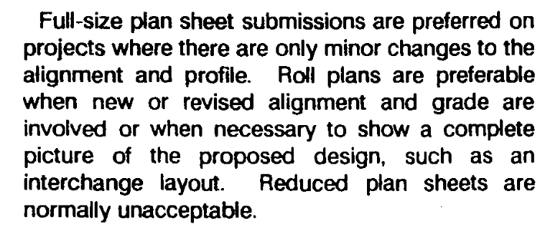
ODOT e+ Plans pilot

Slide 41
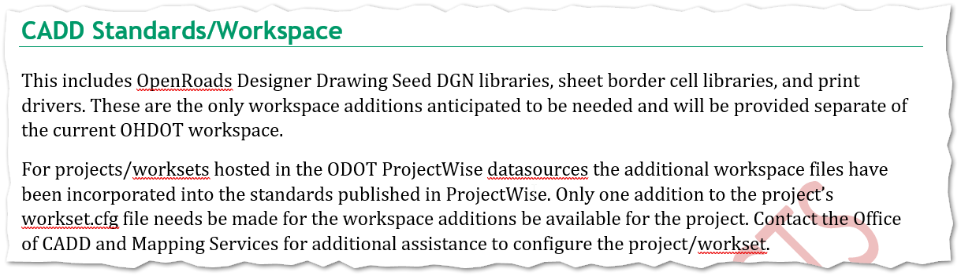
ODOT e+ Plans pilot

Slide 42
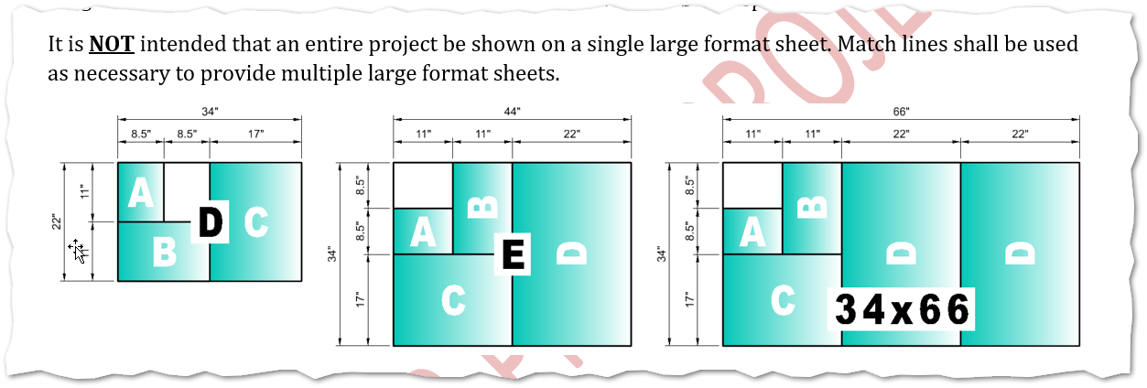
ODOT e+ Plans pilot

Slide 43
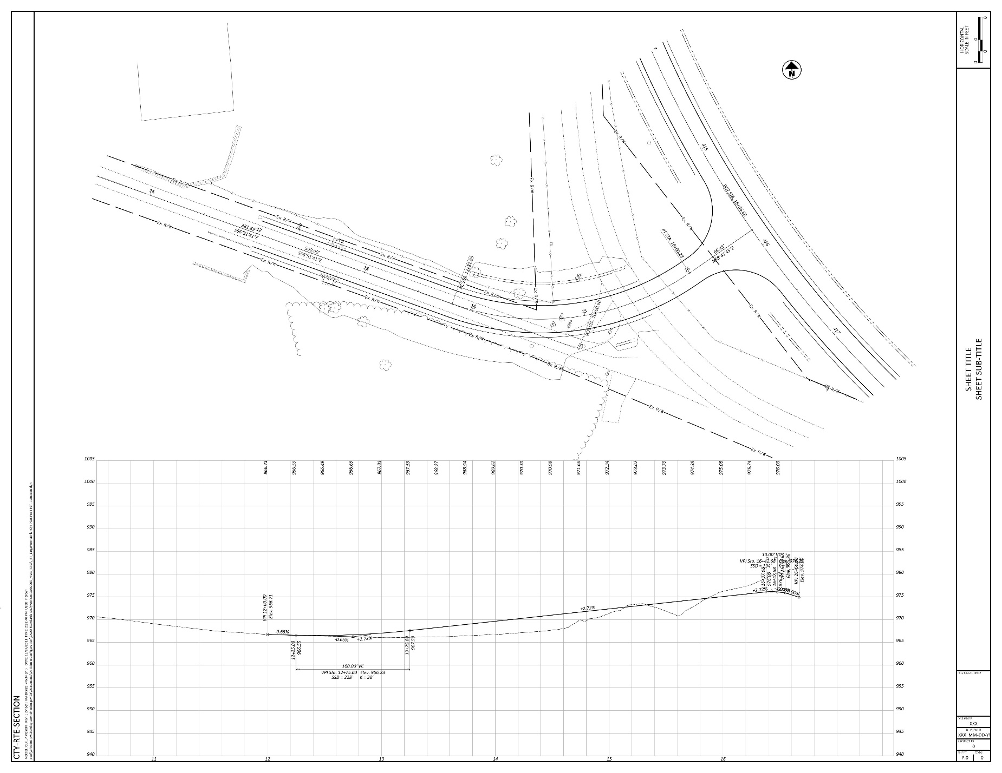
ODOT e+ Plans pilot

Slide 44
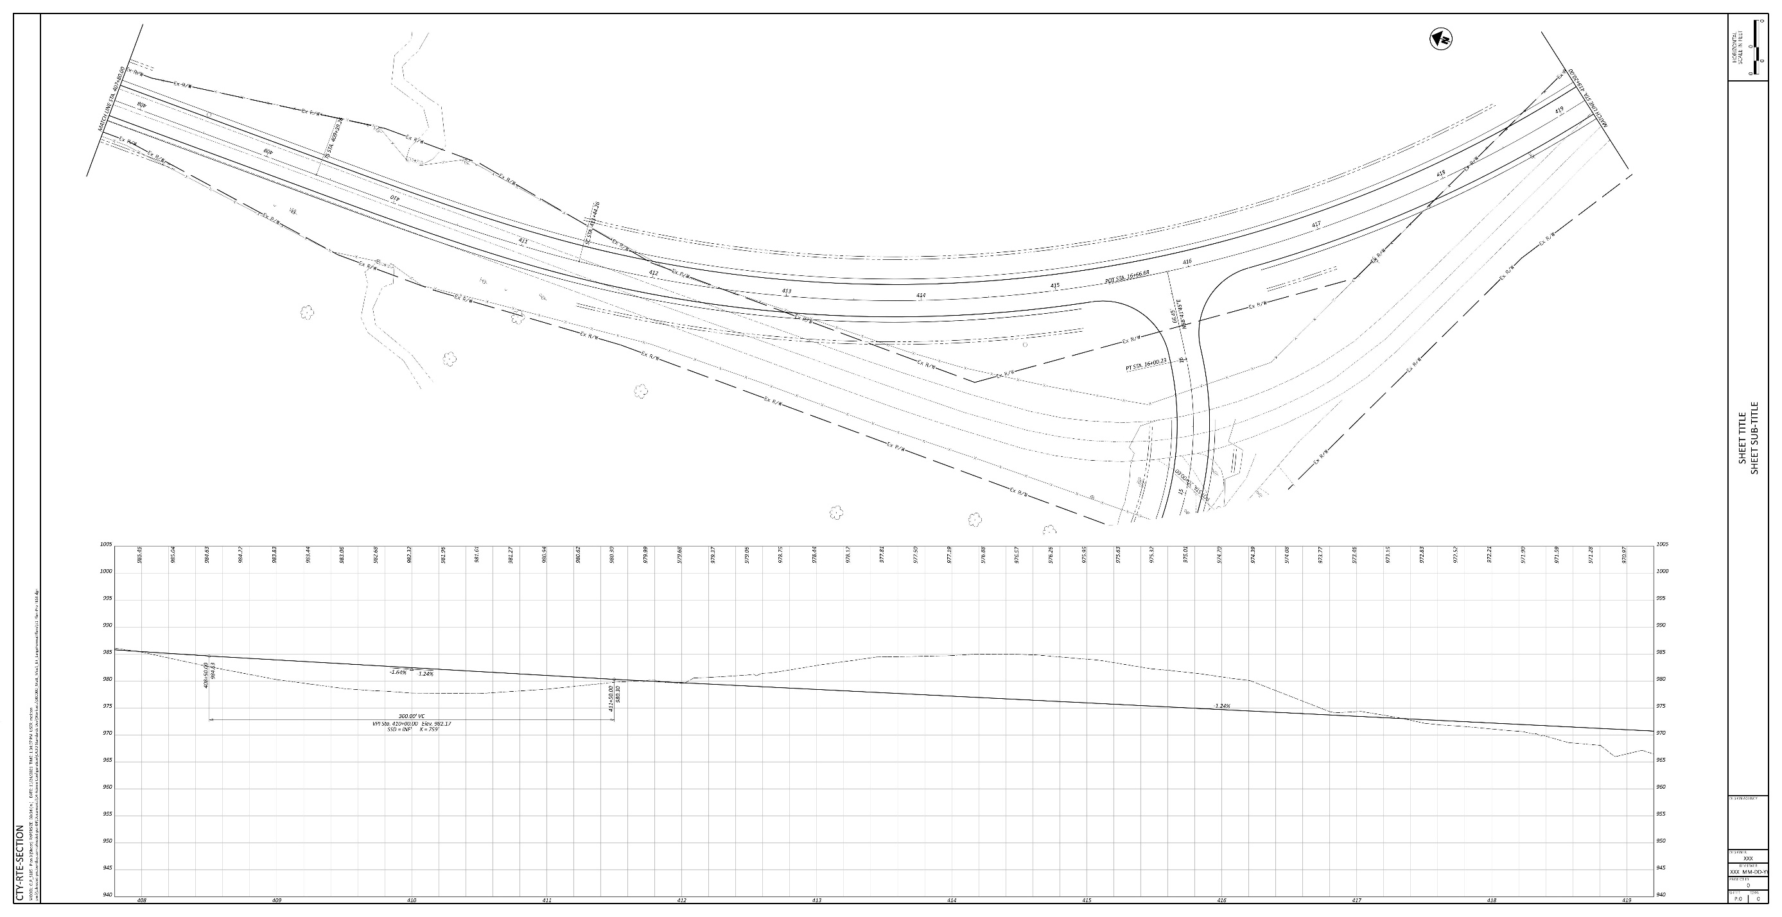
ODOT e+ Plans pilot

Slide 45
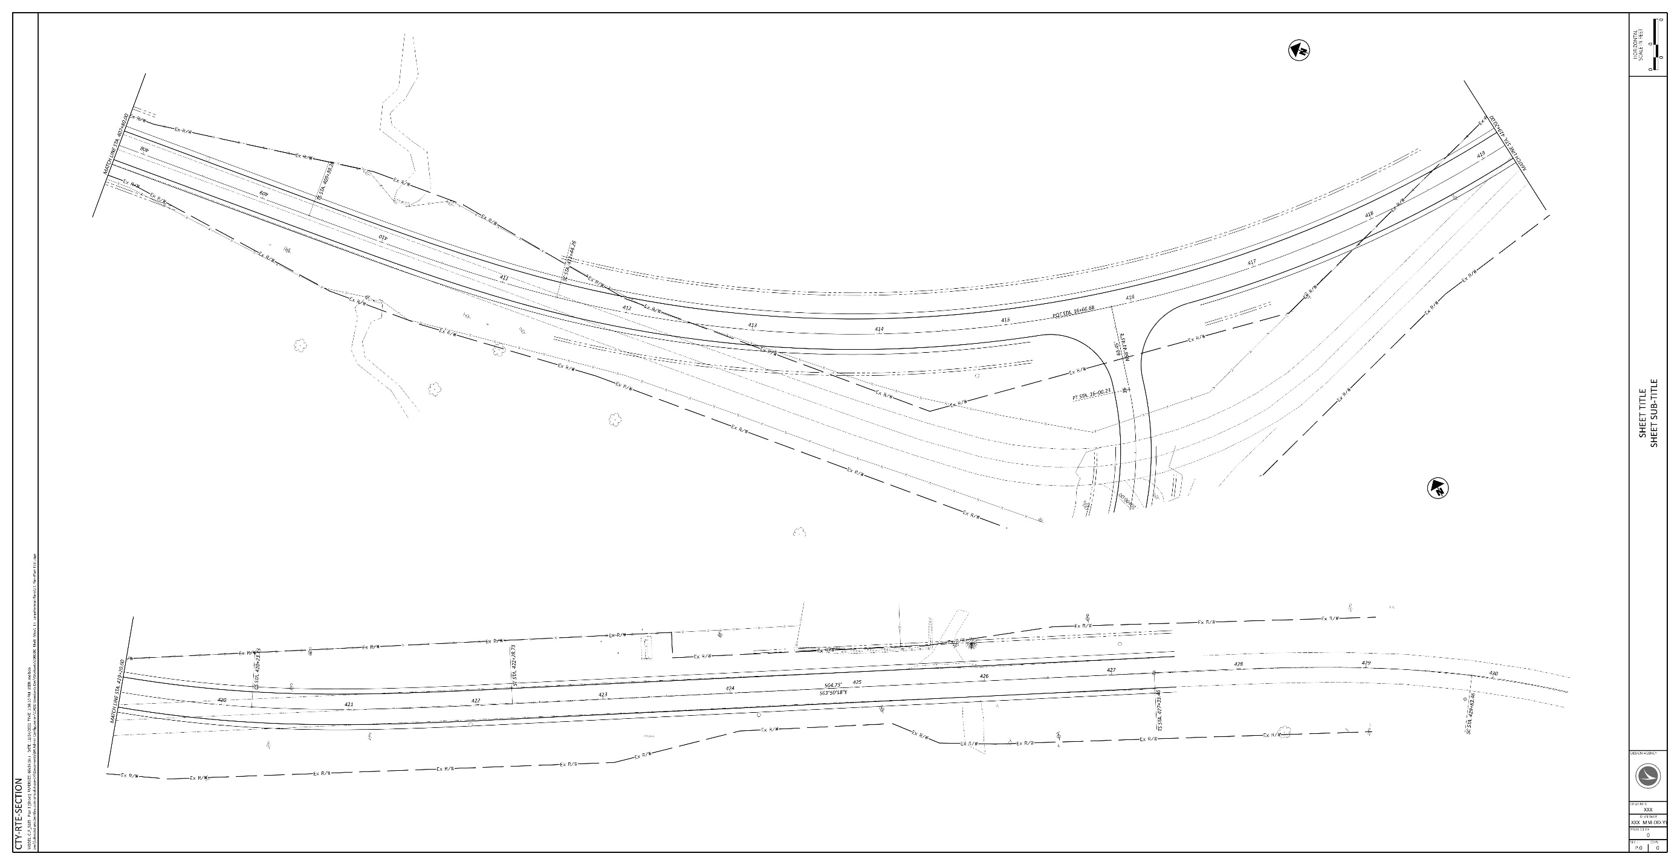
ODOT e+ Plans pilot

Slide 46
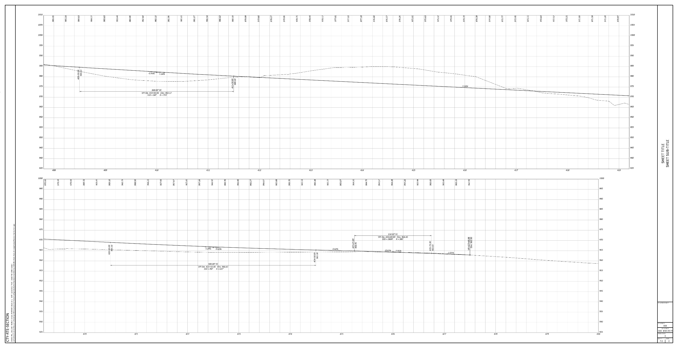
ODOT e+ Plans pilot

Slide 47
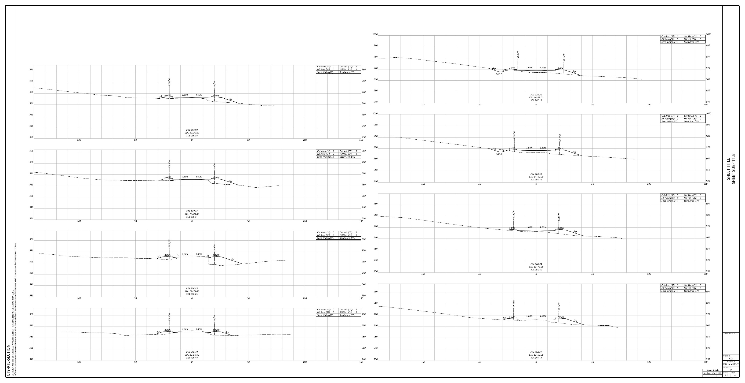
ODOT e+ Plans pilot

Slide 48
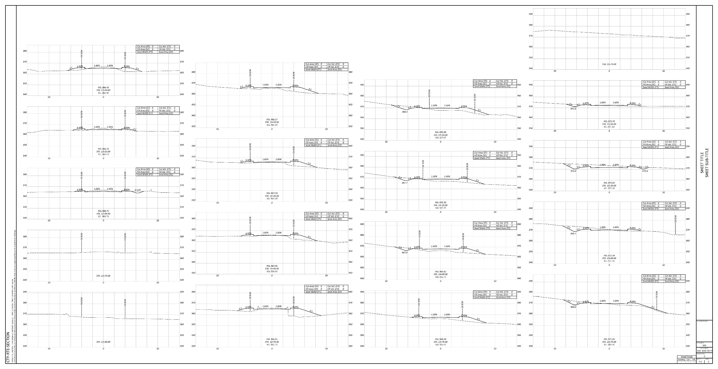
ODOT e+ Plans pilot

Slide 49
ODOT e+ Plans pilot
First Pilot Project:
  District 8 - HAM-75-1.05
    Project Manager Charlie Rowe said,
  “So far we have had one submittal using the roll plots. Everyone loved it.
  It made the review for ODOT significantly easier. No complaints from the consultant either.”
District 4 - Three upcoming projects to pilot.
District 6 – Considering use on upcoming project.
District 12 – One upcoming project.
Your Project ??? Contact me to discuss…

Slide 50
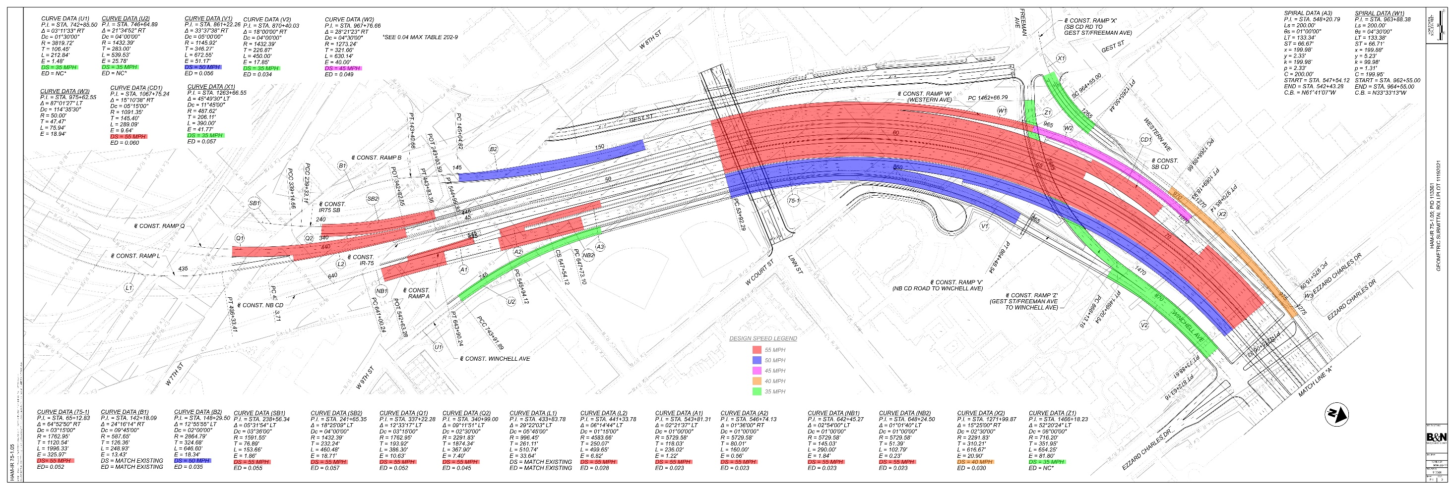
ODOT e+ Plans pilot

Slide 51
Questions
?

Slide 52
File Naming Conventions
Matt Eiben

Slide 53
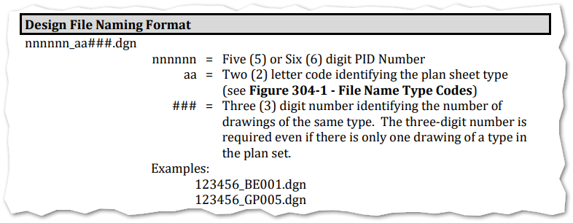
File naming Convention – Possible future revision
Considering a revision to DGN file naming convention(s).
  Bridge, culvert, wall conventions would have similar revisions.

Slide 54
File naming Convention – Possible future revision
Why is there a need for a change?
  NEED TO ELIMINATE DUPLICATE FILENAMES.
    This has always been a challenge for projects with consultants/sub-consultants, etc…

Slide 55
File naming Convention – Possible future revision
Why are there duplicate filenames?
  Several reasons really. Again, not really a new problems.
  Multiple entities working on different portions of project.
  Surveyor delivering horizontal alignments that need proposed vertical geometry changes.
    ORD – since no external database, like GEOPAK .gpk, vertical alignment must be added to same DGN as horizontal alignment.
  ProjectWise – Scan References and Link Sets tool.

Slide 56
File naming Convention – Possible future revision
A new convention must be flexible enough to accommodate:
  Design, bid, build projects;
  Projects/task orders with multiple locations;
  Design-build projects;
  Multiple phase/part projects;
  Projects with heavy collaboration. i.e. multiple consultants, agencies, etc.

Slide 57
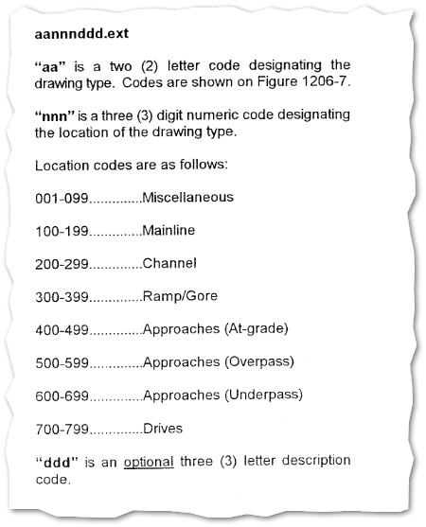
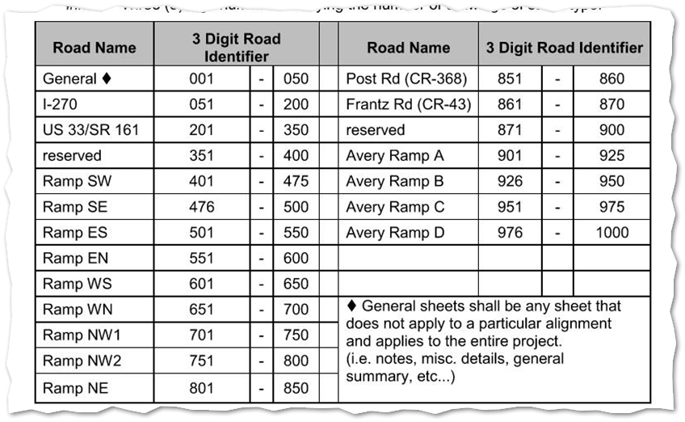
File naming Convention – Possible future revision

Slide 58
File naming Convention – Possible future revision
Minor folder structure/name change.
  Folders ending in:
    x00 – Reserved for ODOT use.
    x01 – Reserved for prime consultant use.
    x02, x03, x04… - For additional sub-consultants.

Slide 59
File naming Convention – Possible future revision
nnnnnn_LLL_CCC_aa###.dgn
LLL - OPTIONAL – 2 or 3 digits for:
Location for multiple site projects (L01, L02, L03);
Design-build buildable unit number (B01, B02, B03);
Phase/part number (P01, P02, P03)
CCC - 3 digit number for agency/consultant owning document;
should match 301, 401, 302, 402 folders.

Slide 60
File naming Convention – Possible future revision
Examples:
  123456_400_BK001.dgn -- ODOT geometry file
  123456_L01_401_BK001.dgn -- Prime Consultant geometry file for Location #2
  123456_402_BK001.dgn - Sub/Survey Consultant geometry file

Slide 61
File naming Convention – Possible future revision
Other ideas – unlikely to be considered:
nnnnnn_LLL_aaC##.dgn
C - One digit number for agency/consultant owning document. . To match last digit(s) of 301, 401, 302, 402 folders.
nnnnnn_LLL_CCC_BBBBBBB_aa###.dgn
BBBBBBB - Alignment name. matches geometry name
(i.e. CLPS185, CLXI071)
### - Could be optional. Would recommend all sheets in same DGN; no more “one sheet per DGN”.

Slide 62

File naming Convention – Possible future revision
Poll: https://forms.office.com/g/v7AJmjbCbx

Slide 63
Questions
?

Slide 64
International Foot
Kyle Ince, P.E., S.I.

Slide 65
Two feet
Two versions of same unit in current use
  “New” international foot and “old” U.S. survey foot
  “New” shorter than “old” by 2 ppm (0.01 ft per mile)
  A real problem with real costs
What’s in a name? Why the change?
  “U.S. survey” versus “international”
Who is using U.S. survey feet?
  Surveyors exclusively, in most (not all) states
  But it impacts everyone

Slide 66

Two feet
2 parts per million (ppm)
1,000,000.00 sft = 999,998.00 ift
10,000,000.00 sft = 9,999,980.00 ift
International → 1 ft = .3048 m
US → 1 ft = .30480061 m (approx.)
  frequently calculated by $\frac{1200}{3937}$
Notes:
Since 1893, the United States has defined the foot based on the meter. The definition adopted at that time was 1 foot = 0.3048006 meter approximately. In 1959, the definition was revised to 1 foot = 0.3048 meter exactly. This change was made to support U.S. industry and international trade and resolved a long-standing discrepancy between the definition used by U.S. industries and that used by other countries. The 1959 redefinition of the foot was legally binding and intended for the entire U.S. A single exception allowed temporary continued use of the previous definition exclusively for geodetic surveying.
NGS - NGS and NIST to Retire U.S. Survey Foot after 2022 | News | National Geodetic Survey (noaa.gov)

Slide 67
Two feet
What situations will this matter?
      Not typically in lengths/distances but in published planar coordinate systems
Why would planar coordinates have trouble?
      SPCS and UTM are very popular, and both fall victim to mix-ups
        Large false eastings and northings
  Is the US Survey Foot really going to go away?
    Not completely (we still use chains, poles, etc.)

Slide 68




Getting ready for International Feet!
Have started to convert OHDOTCEv02 workspace form Survey Feet to International Feet.

Slide 69
Getting ready for International Feet!
Goal is to NOT make a 3rd version of our workspace.
Set per WORKSET!!!
MUST BE EVEN MORE DELAGENT WITH SEED FILES AND WORKING UNITS!
Will provide more info closer to implementation

Slide 70
Low Distortion Projection (LDP)
Kyle Ince, P.E., S.I.

Slide 71
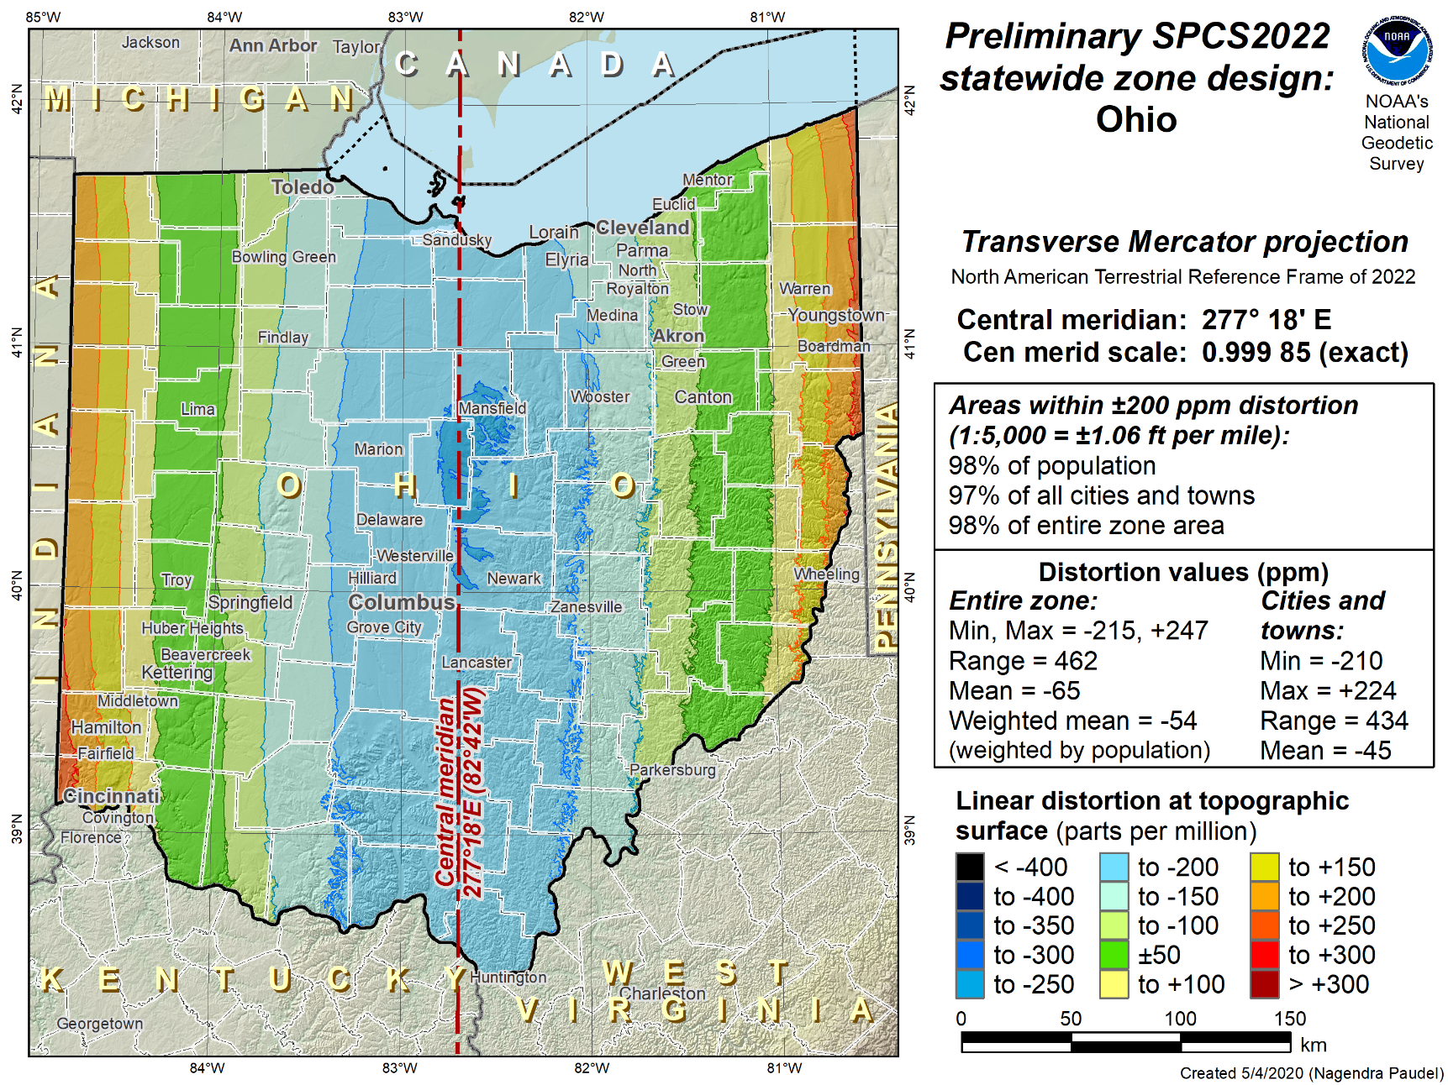
Low Distortion Projection (LDP)
Ohio Single Zone
  Single State Plane Zone Base Layer for Large Scale GIS Applications “OGRIP”
  Transverse Mercator Projection Scaled to the Topographic Surface
  98% of State within 200 ppm or 1:5,000
Ohio DOT CADD Users Group Meeting - 04/13/2022

Slide 72
Low Distortion Projection (LDP)
2nd Layer: Low Distortion Layer
  Based on County Boundaries
  Goal was to have linear distortion reduced to 10 ppm or less
  Have received preliminary approval from NGS on Designs
  ODOT to implement for internal use Jan. 1, 2023 (coincide with the implementation of the international foot).

Slide 73
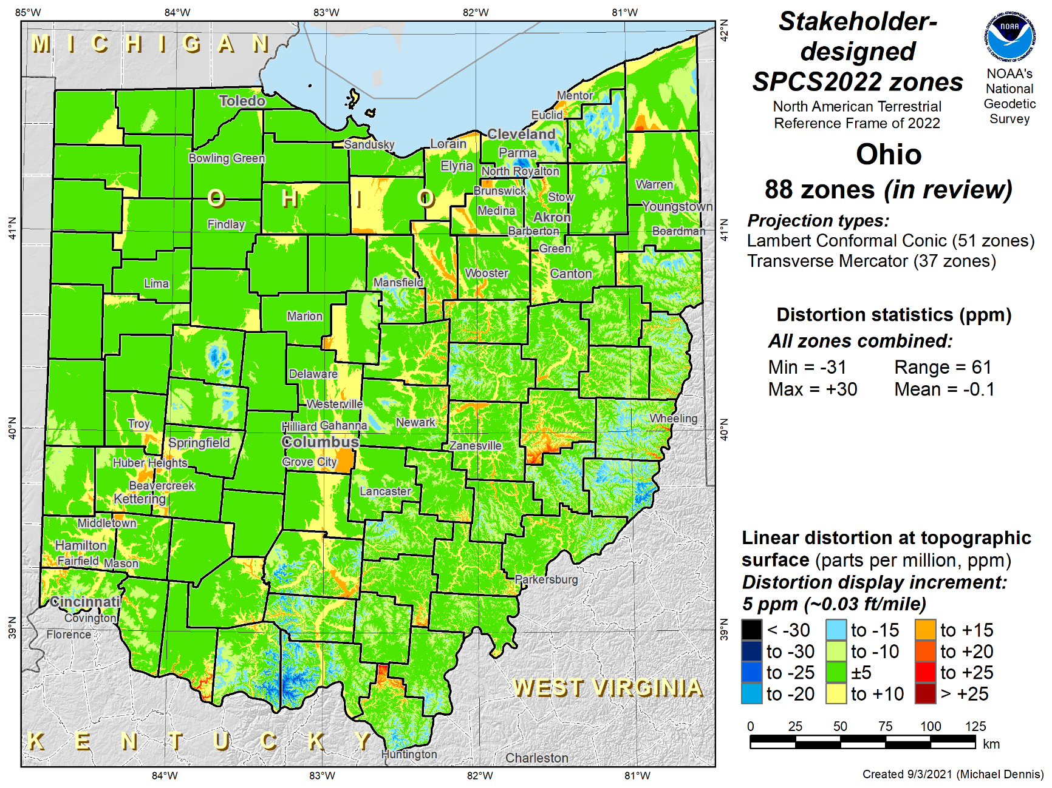
Low Distortion Projection (LDP)

Slide 74
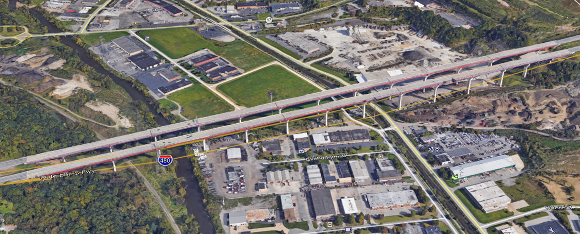
Low Distortion Projection (LDP) Examples
Cuyahoga County
I-480 Valley View Bridge
I-480 BRIDGE SPAN
 | Grid | Ground | Diff. | feet per mile | parts per million | 1/
STATE PLANE | 4191.688 | 4192.004 | -0.316 | -0.398 | -75 | 13266
20 PPM | 4191.920 | 4192.004 | -0.084 | -0.106 | -20 | 49905
LDP | 4191.995 | 4192.004 | -0.009 | -0.011 | -2 | 465778

Slide 75
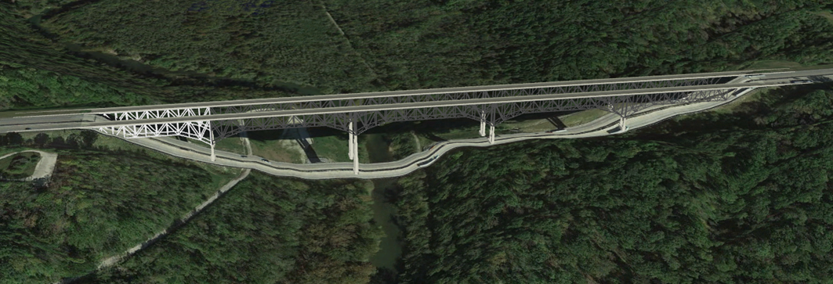
Low Distortion Projection (LDP) Examples
Warren County
Jerimiah-Morrow Bridge
JERIMIAH MORROW BRIDGE
 | Grid | Ground | Diff. | feet per mile | parts per million | 1/
STATE PLANE | 2224.093 | 2224.317 | -0.224 | -0.532 | -101 | 9930
20 PPM | 2224.272 | 2224.317 | -0.045 | -0.107 | -20 | 49429
LDP | 2224.313 | 2224.317 | -0.004 | -0.009 | -2 | 556079

Slide 76
Building Information Modeling for Infrastructure (BIM)
Kyle Ince, P.E., S.I.

Slide 77

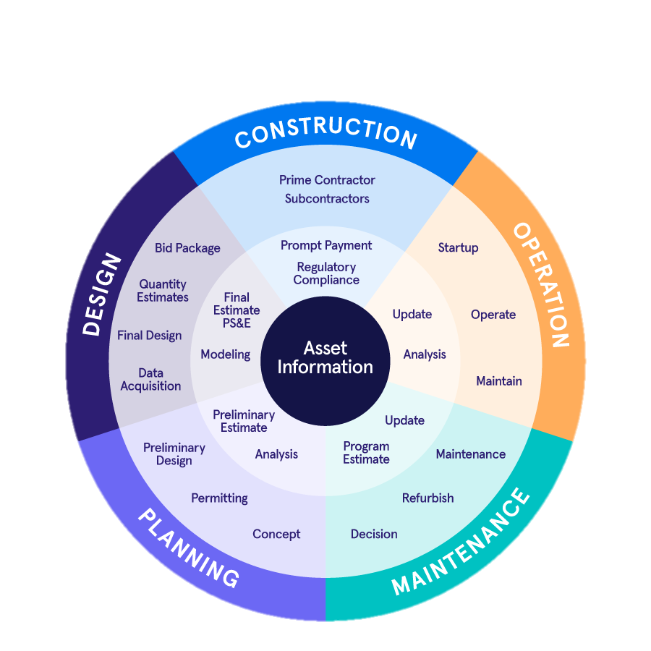
BIM for Infrastructure (What is it?)
Building Information Modeling (BIM)
  BIM is a collaborative work method for structuring, managing, and using digital data and information about transportation assets throughout their lifecycle
https://www.infotechinc.com/blog/building-information-modeling-for-infrastructure-just-what-is-it/

Slide 78
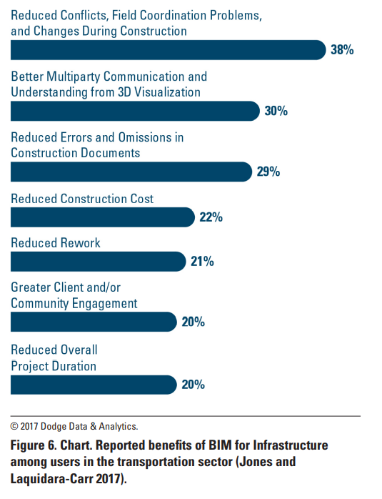
BIM for Infrastructure (Benefits)
Building Information Modeling (BIM)
Reduce redundant data collection efforts
Eliminate inconsistent terms and definitions for data across enterprise systems
Enable data sharing across business units
Reduce construction cost overruns related to communication and coordination challenges
Higher quality, reliable data for decision making across asset lifecycle
Visualize / communicate project phases
Known location of as-builts

Slide 79
BIM for Infrastructure (Current Status)
Building Information Modeling (BIM)
  Figuring out what BIM means to ODOT and our strategic partners
    Polling internal and a select few external users
      Interested in being involved? Let me know!
    Developing realistic next steps and a general recommendation

Slide 80
Questions
?

